Slide 1
Artificial Intelligence: Optimization models 2
Santosh GSK
Industry Expert- AI

Slide 2
Optimization Models
Local search algorithms – Search in the state-space in the neighborhood of current position until an optimal solution is found
Hill Climbing Algorithm and its variants
Simulated Annealing
Local Beam Search
Population based algorithms – Instead of single instance in state-space, use multiple parallel instances (i.e., population) in finding the optimal solution
Genetic Algorithms
Particle Swarm Optimization
Ant Colony Optimization

Slide 3
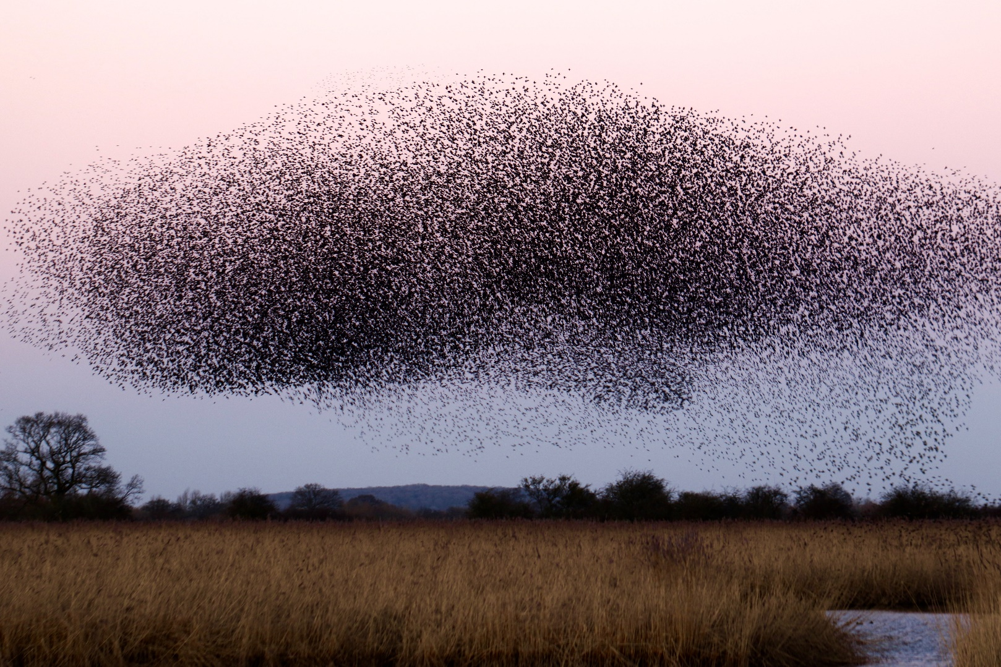
Particle Swarm Optimization
Swarm of birds

Slide 4
Particle Swarm Optimization (PSO)
Population based stochastic optimization technique
A form of Swarm Intelligence
Similar to the Evolutionary Computation techniques, like GA
Unlike in GA, PSO has no evolution operators like crossover, mutation
PSO is demonstrated to get results better, faster and cheaper.
PSO has few parameters to tune

Slide 5
Particle Swarm Optimization (PSO)
Each individual is called a particle
A particle would follow the swarm for a desirable end goal
However, if one particle sees a desirable path, the rest of the swarm would follow
It would also explore in the local space independently
This ensures that the swarm would have a certain explorative capability

Slide 6
Particle Swarm Optimization (PSO)
In multidimensional space, Particles are defined with
Position
Velocity
Two essential reasoning capabilities
Their memory of their own best position
Knowledge of Swarm’s best (i.e., position with smallest objective value)

Slide 7
Particle Swarm Optimization (PSO)
Particles adjust their position and velocity
Using the good positions communicated by members of swarm
This is achieved in two ways
Global best (pbest): Known to all and immediately updated when new position is found by any particle
Local best / neighborhood best (lbest): Each particle communicates only with a subset of swarm about best positions.
PSO concept is about adjusting the velocity of each particle toward its pbest and lbest locations.

Slide 8
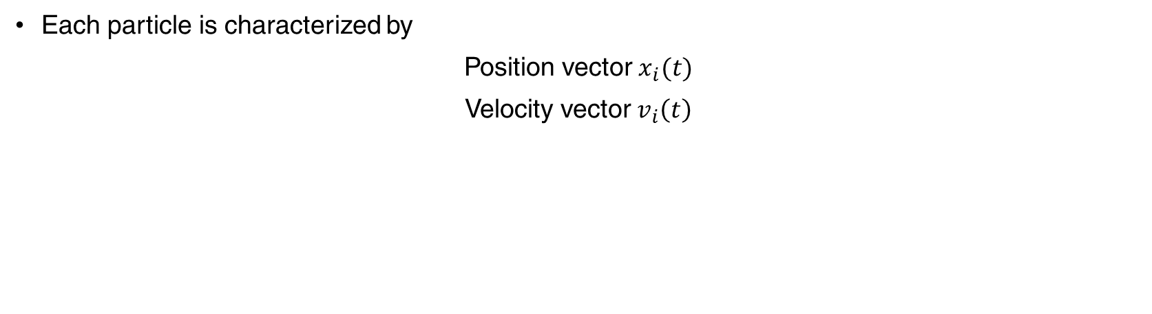
Particle Swarm Optimization (PSO)
Each particle is characterized by
Position vector $x_{i}(t)$
Velocity vector $v_{i}\left(t\right)$

Slide 9
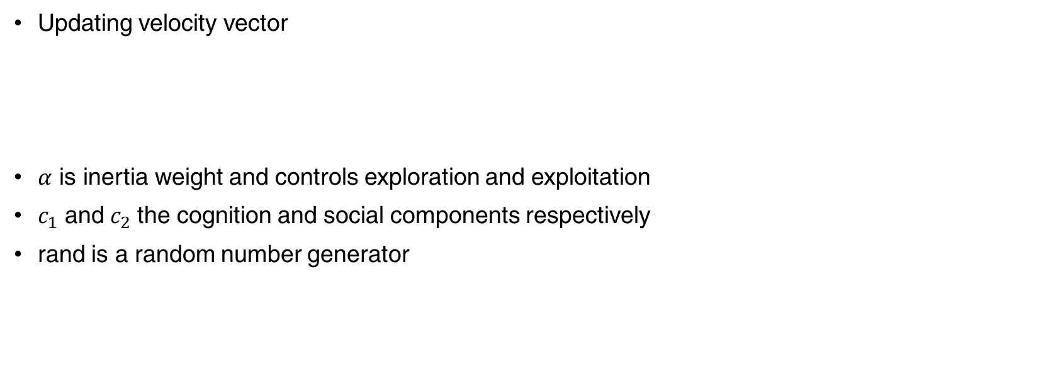
Particle Swarm Optimization (PSO)
Updating velocity vector
$α$ is inertia weight and controls exploration and exploitation
$c_{1}$ and${ c}_{2}$ the cognition and social components respectively
rand is a random number generator

Slide 10
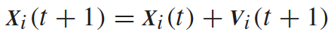
Particle Swarm Optimization (PSO)
Updating position vector
The above two updates are performed for each particle in every iteration

Slide 11
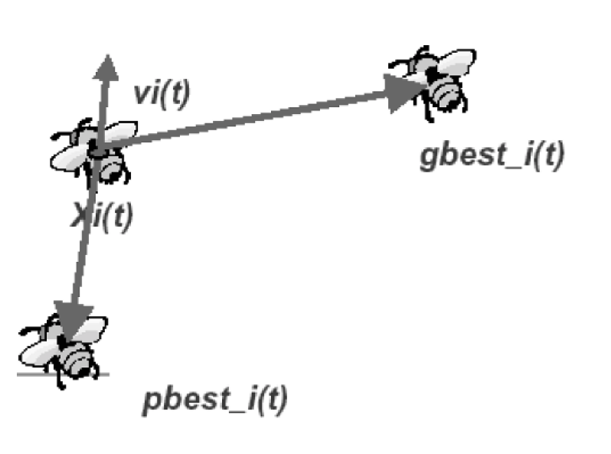
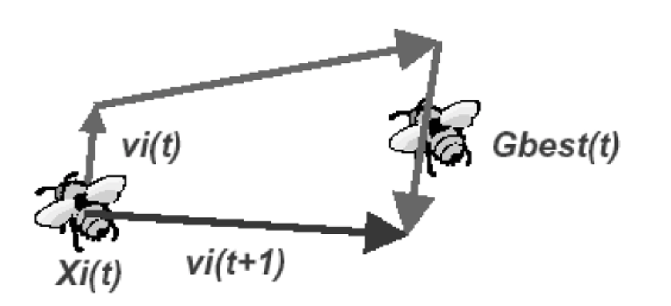
Particle Swarm Optimization (PSO)

Slide 12
Particle Swarm Optimization (PSO)
Basic Flow of PSO
Initialize the swarm with random initializations
Evaluate fitness value for each of these individuals
Modify gbest, pbest, and velocity
Move each particle to new particle
Goto step 2, and repeat until convergence
Particles velocities on each dimension are clamped to a max velocity v_{max}

Slide 13
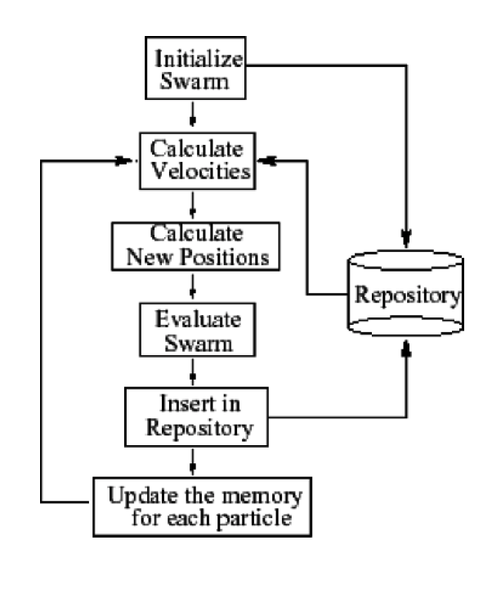
Particle Swarm Optimization (PSO)

Slide 14
PSO vs GA
Most of evolutionary algorithms follow a procedure
Random generation of initial population
Measuring a fitness value for each subject depending on the distance to optimum
Reproduction of population based on fitness values
If requirements are met, then stop, else go to Step 2
From above procedure PSO shares many common points with GA

Slide 15
PSO vs GA
Common points
Both algorithms start with a group of randomly generated population
Both have fitness value to evaluate the population
Both update the population and search for optimum with random sampling
Both do not guarantee success
Difference
PSO does not have genetic operators like crossover and mutation
Particles update themselves
They also have memory which is critical to the algorithm
In GA, the information is shared between individuals, in PSO, the information is shared one-way.

Slide 16
PSO vs GA
Advantages
PSO is easy to implement and have few parameters to tune
All particles tend to converge to best solution quickly even in local version in most cases
Disadvantages
Strength of GA comes in the parallel nature of its search
It preserves multiple solutions and eradicates unpromising solutions

Slide 17
PSO Applications
Power systems operations and control
Job Scheduling problems
Vehicle routing
Mobile networking
Modeling optimized parameters
Batch process scheduling
Multi-objective optimization problems
Image processing and pattern recognition problems

Slide 18
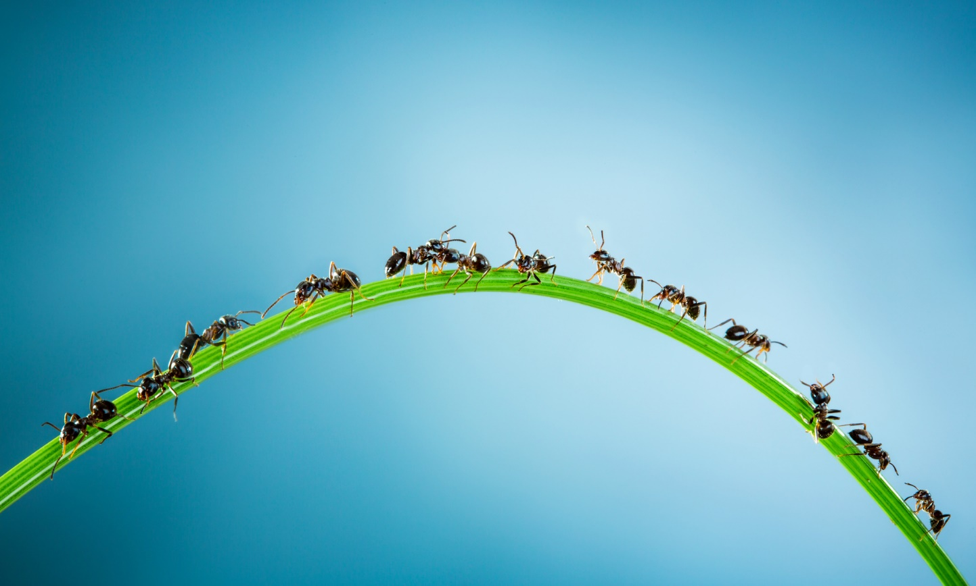
Ant Colony Optimization (ACO)

Slide 19
Ant Colony Optimization (ACO)
ACO is a population based, general search technique for solution of difficult combinatorial problems
Inspired by Pheromone trail laying behavior of real ant colonies.

Slide 20
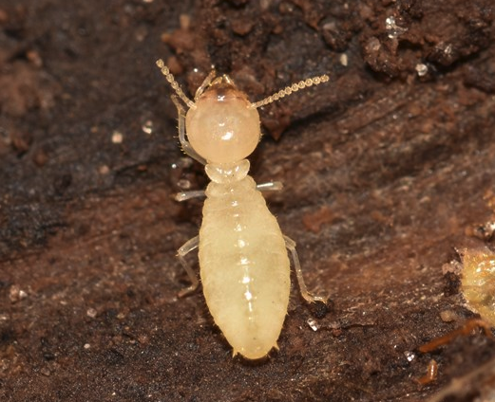
ACO: Biological Inspiration
Biological Inspiration: In 1940s, French entomologist Pierre-Paul Grass observed the effect of “significant stimuli” in termites

Slide 21
ACO: Real Ants
As ants have weak vision and weak memory, they communicate using the stimulus
They leave chemical deposits called Pheromone to inform other ants about food, colonies, etc.
Using olfactory stimulus the insects follow the trail left behind by other ants

Slide 22
ACO: Real ants communication
He referred to this communication as Stigmergy
Workers are stimulated by the performance they have achieved
Two main characteristics of Stigmergy
Indirect, asynchronous, non-symbolic form of communication mediated by environment
Information is local

Slide 23
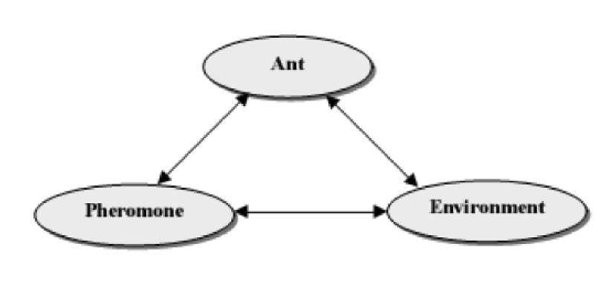
ACO: Real ants communication
As the Stigmergy communication is asynchronous
Insects doesn’t have to be at the same place at the same time to receive the communication
Other ants follow the pheromone trail and deposit even more pheromone leading to a positive feedback effect, if the selected path is good.

Slide 24
ACO: Real ants communication
Using Stigmergy, ants are capable of finding shortest path from food source to their nest without visual cues

Slide 25
ACO: Finding Shortest Path
They adapt based on the changes to the environment
Finding a new shortest path once the old one is no longer feasible due to an obstacle
A little pheromone lead other ants to follow the path, depositing even more pheromone
This leads to positive feedback effect, if selected path is good
Ants prefer to follow a path with rich in pheromone

Slide 26
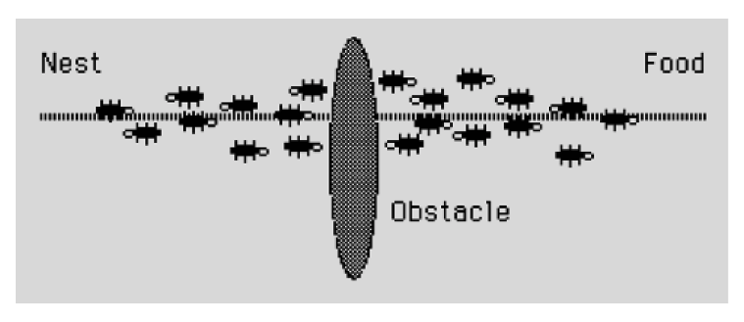
ACO: Finding Shortest Path
Ants on a straight line path are given an obstacle

Slide 27
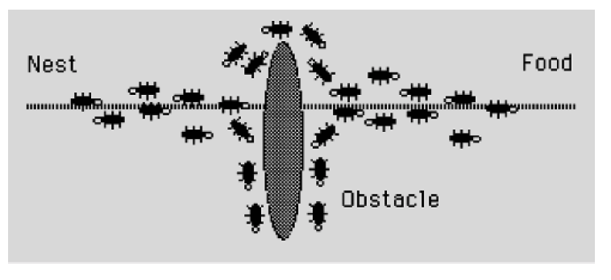
ACO: Finding Shortest Path
If an obstacle is presented, random half of the ants take a left, another half take a right

Slide 28
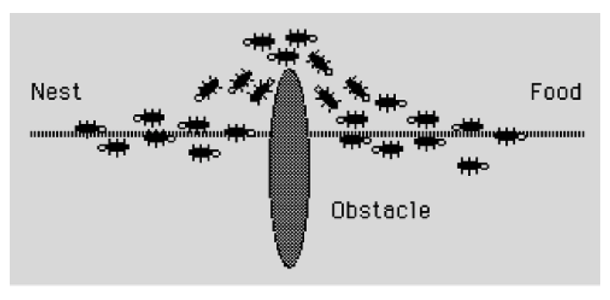
ACO: Finding Shortest Path
Post obstacle, the ants on the shorter path lay pheromone quicker leading other ants to follow the shorter path

Slide 29
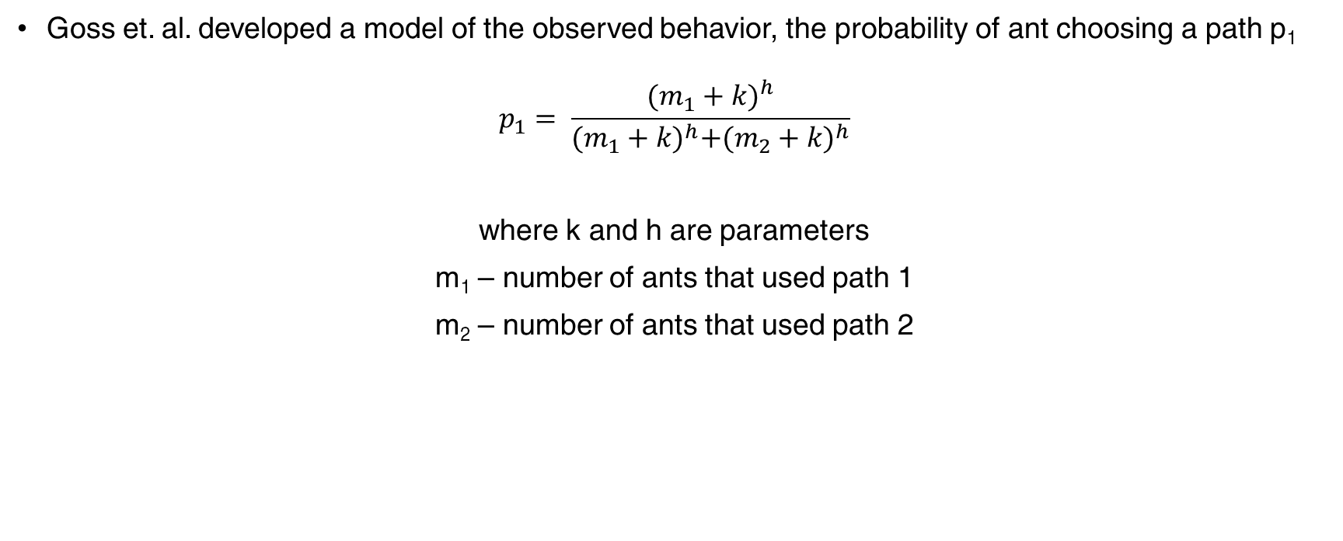
ACO: Modeling Shortest Path
Goss et. al. developed a model of the observed behavior, the probability of ant choosing a path p₁
$$p_{1}= \frac{{(m_{1}+k)}^{h}}{{(m_{1}+k)}^{h}+{(m_{2}+k)}^{h}}$$
where k and h are parameters
m₁ – number of ants that used path 1
m₂ – number of ants that used path 2

Slide 30
Ant Colony Optimization (ACO)
In ACO, artificial ants search for good solutions to a given optimization problem
Therefore, optimization problems are converted into a problem of finding best path on a weighted graph

Slide 31
Ant Colony Optimization (ACO)
The artificial ants incrementally build solutions by moving on the graph
The movements on the graph are determined at runtime by a Pheromone model
A Pheromone model is a set of parameters associated with graph components (nodes/edges)

Slide 32
ACO: Similarities with Real Ants
ACO is about adapting the concepts of real ants in solving optimization problems.
They share the following similarities
Colony of individuals: Both real ants and artificial ants are composed of a population, or colony of independent individual agents
Pheromone trail and stigmergy: While real ants deposit chemical substance on the visited state, artificial ants change numerical information of problem state, stored locally when that state is visited
Pheromone Evaporation: In ACO and real ants it is important to slowly forget the history to avoid stacking in local extremes and move toward new regions
Shortest Path Search: Both optimize for shortest paths despite having different transition behavior
Transition Policy: Decision making is based on probabilistic inference. It depends on local state information and existing pheromone trails
Deposited amount of Pheromone: Depends on quality of discovered food source / solution

Slide 33
ACO: Differences with Real Ants
Artificial ants live in discrete world.
Artificial ants have memory, they could remember states that have been visited
Pheromone deposit methodology is significantly different. Timing in pheromone laying is problem dependent and often does not have similarities with real ants methodology
ACO algorithms could contain local optimization techniques to improve solutions

Slide 34
ACO: Characteristics
Natural Algorithm – based on real ants movement from colonies to food
Parallel and distributed – a population of agents moving simultaneously, independently and without supervision
Cooperative – As each agent passes information to other ants by laying pheromone trails
Versatile – Can be applied to similar versions of same problem, e.g., TSP to Asymmetric TSP
Robust – Can be applied with minimal changes to other problems like Quadratic Assignment (QSP), Job-shop scheduling (JSP)

Slide 35
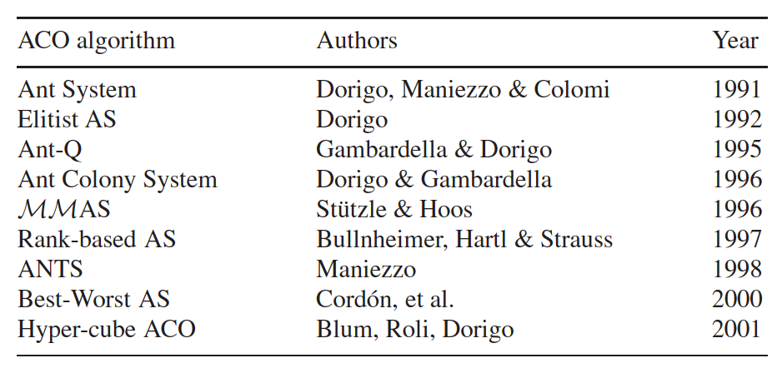
ACO Algorithms
There are many algorithms that are built based on the pheromone structure

Slide 36
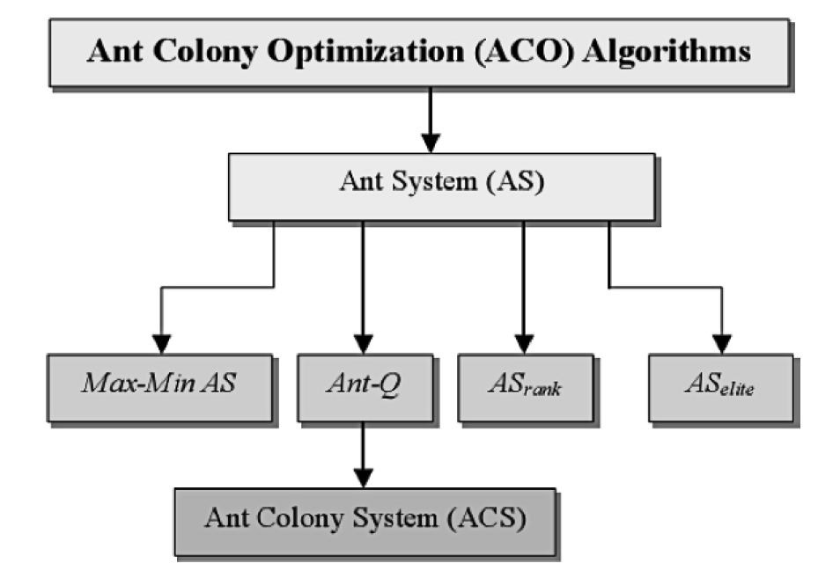
ACO Algorithms

Slide 37
ACO Algorithms: Ant System
Ant System (1991)
Parallel search over several threads based on
Local problem information
Historical data over previous trails stored as dynamic memory
Collective behavior emerging from interaction of different search threads has proved efficient

Slide 38
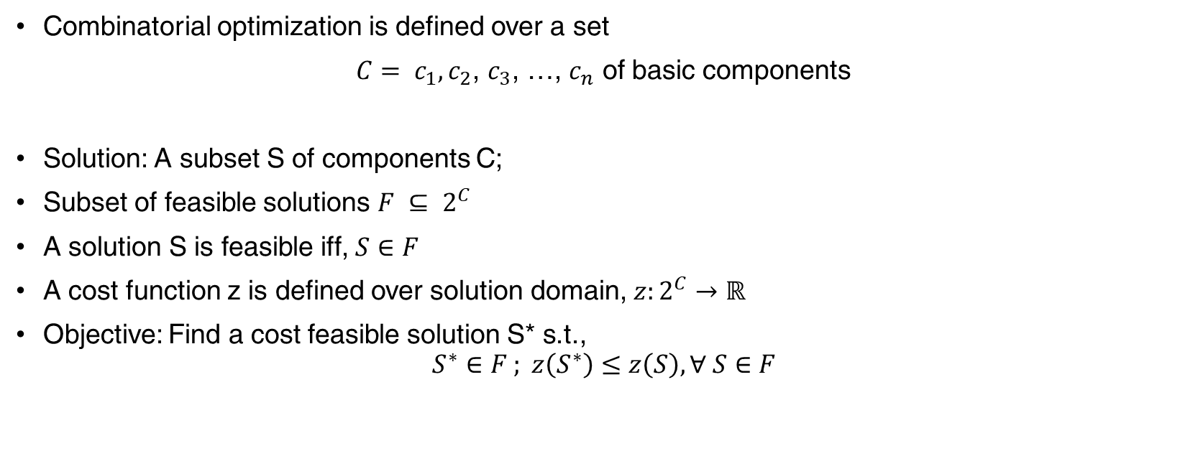
ACO: Notation
Combinatorial optimization is defined over a set
$C= c_{1},c_{2}$, $c_{3}$, …, $c_{n}$ of basic components
Solution: A subset S of components C;
Subset of feasible solutions $F ⊆ 2^{C}$
A solution S is feasible iff, $S∈F$
A cost function z is defined over solution domain, $z:2^{C}→ℝ$
Objective: Find a cost feasible solution S* s.t.,
$$S^{∗}∈F ; z\left(S^{∗}\right)≤z\left(S\right), ∀ S∈F$$

Slide 39
ACO General Framework
Given the notation above, ACO works with
Computational concurrent and asynchronous agents (colony of ants)
They move through states of problem
They move by applying a stochastic local decision policy based on two parameters, trails and attractiveness
When an ant completes a solution, or during construction phase, the solution is evaluated and trail values on components are modified

Slide 40
ACO General Framework
Additionally, an ACO algorithm has two more mechanisms, trail evaporation and optionally daemon actions
Trail Evaporation decreases trail value over time in order to avoid unlimited accumulation of trails over some component
Daemon actions are implemented centrally such as Invocation of local optimization procedure, update of global information. They are not performed by single ants.

Slide 41
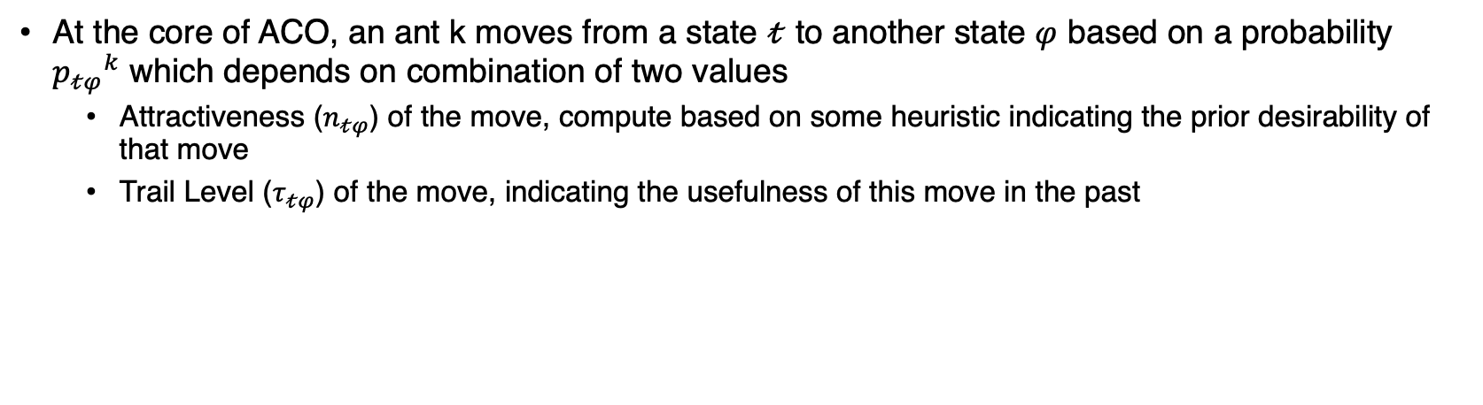
ACO General Framework
At the core of ACO, an ant k moves from a state $𝓉$ to another state $φ$ based on a probability ${p_{𝓉φ}}^{k}$ which depends on combination of two values
Attractiveness ($n_{𝓉φ}$) of the move, compute based on some heuristic indicating the prior desirability of that move
Trail Level ($τ_{𝓉φ}$) of the move, indicating the usefulness of this move in the past

Slide 42
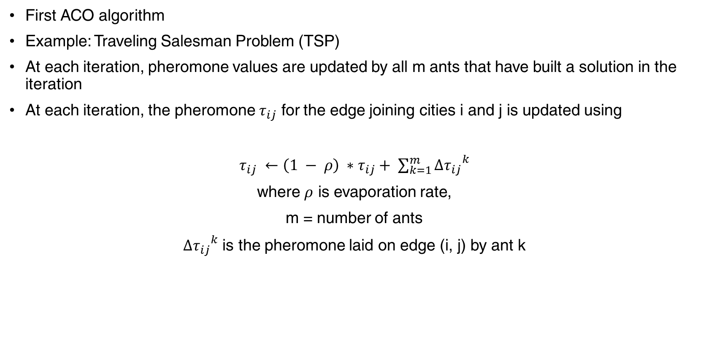
Ant System
First ACO algorithm
Example: Traveling Salesman Problem (TSP)
At each iteration, pheromone values are updated by all m ants that have built a solution in the iteration
At each iteration, the pheromone $τ_{ij}$ for the edge joining cities i and j is updated using
$τ_{ij} ←\left(1 − ρ\right) ∗τ_{ij}+ \sum_{k=1}^{m}{{{Δτ}_{ij}}^{k}}$
where $ρ$ is evaporation rate,
m = number of ants
${{Δτ}_{ij}}^{k}$ is the pheromone laid on edge (i, j) by ant k

Slide 43
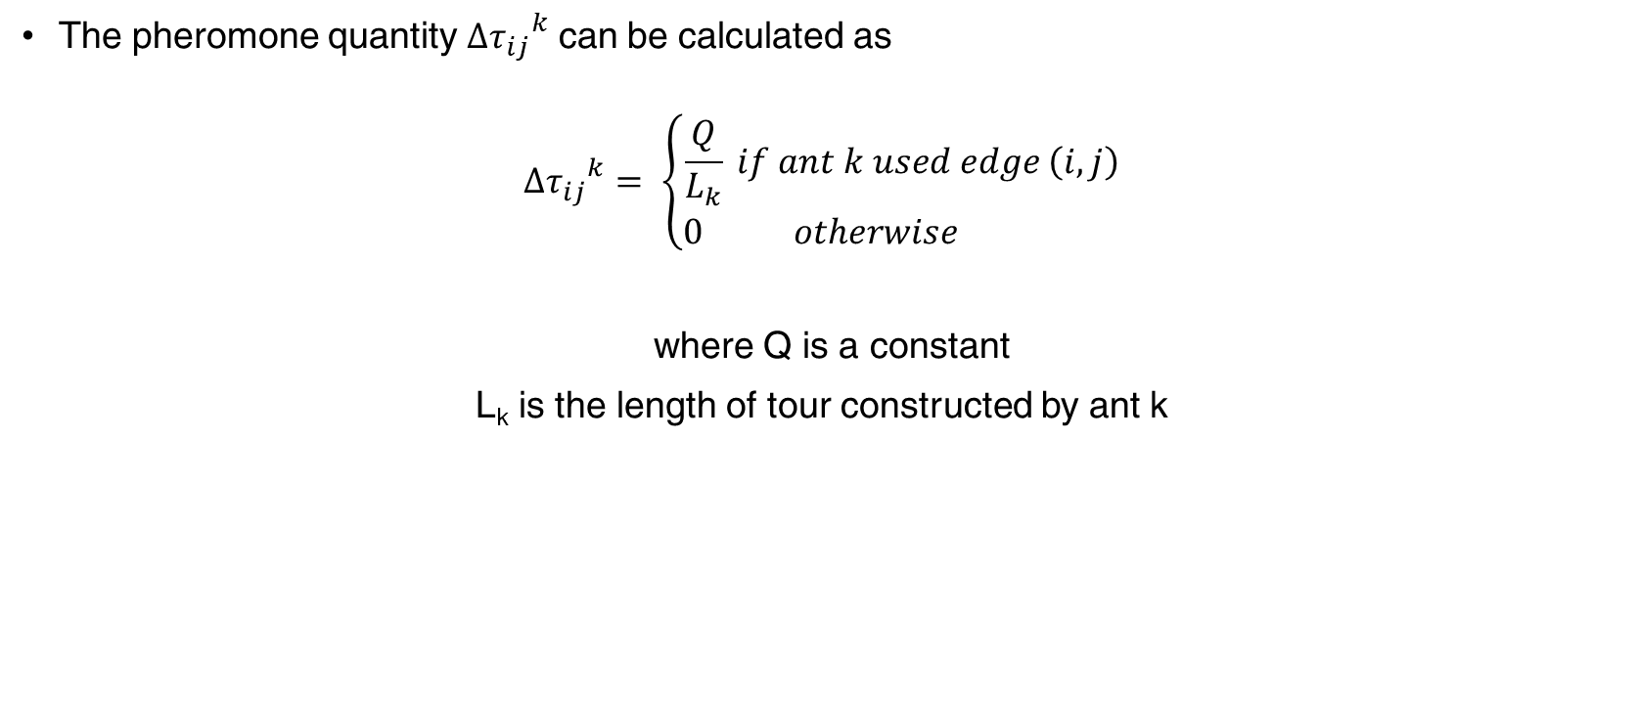
Ant System
The pheromone quantity ${{Δτ}_{ij}}^{k}$ can be calculated as
$${{Δτ}_{ij}}^{k}= \left\{\begin{aligned}\frac{Q}{L_{k}} if ant k used edge \left(i,j\right) \\ 0 otherwise \end{aligned}\right.$$
where Q is a constant
L_{k} is the length of tour constructed by ant k

Slide 44
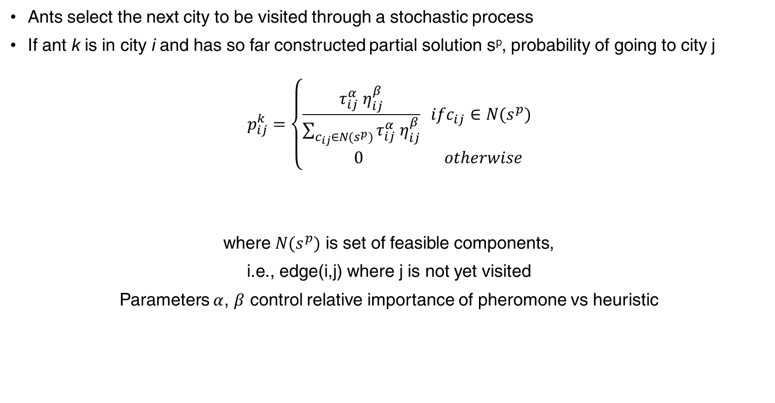
Ant System
Ants select the next city to be visited through a stochastic process
If ant k is in city i and has so far constructed partial solution s^{p}, probability of going to city j
$$p_{ij}^{k}=\left\{\begin{aligned}\frac{τ_{ij}^{α} η_{ij}^{β}}{\sum_{c_{ij}∈N(s^{p})}{τ_{ij}^{α} η_{ij}^{β}}} ifc_{ij}∈N(s^{p}) \\ 0 otherwise \end{aligned}\right.$$
where $N(s^{p})$ is set of feasible components,
i.e., edge(i,j) where j is not yet visited
Parameters $α$, $β$ control relative importance of pheromone vs heuristic

Slide 45
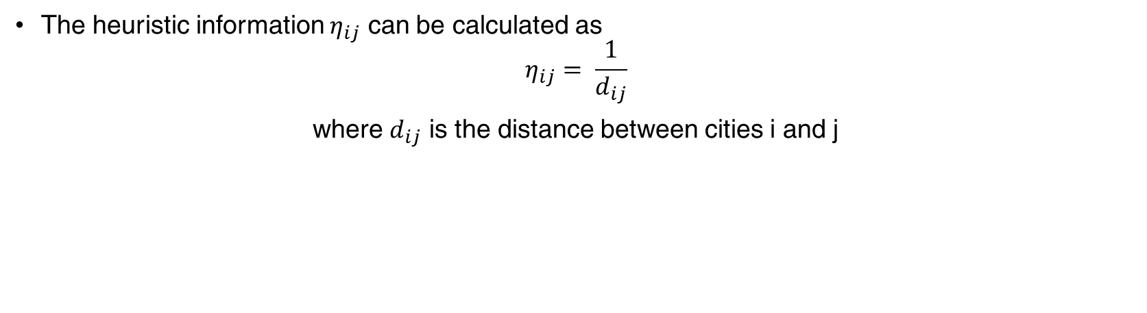
Ant System
The heuristic information $η_{ij}$ can be calculated as
$$η_{ij}= \frac{1}{d_{ij}}$$
where $d_{ij}$ is the distance between cities i and j

Slide 46
Ant Colony System
In Ant Colony System, unlike Ant System
a local pheromone update is performed
in addition to the pheromone update performed at the end of construction process
A Local pheromone update is performed by all ants after each construction step.

Slide 47
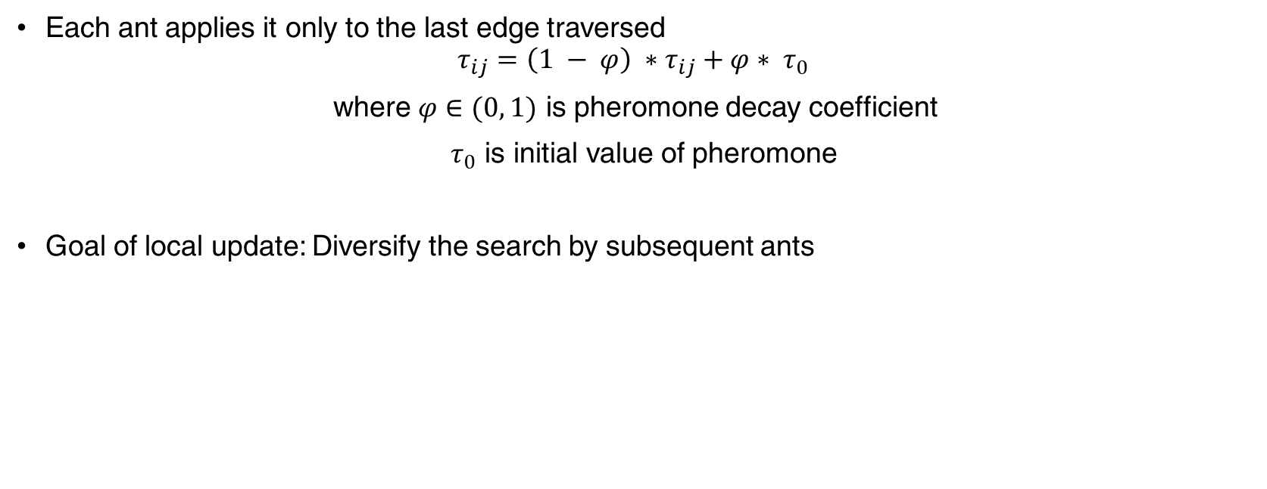
Ant Colony System: Local Update
Each ant applies it only to the last edge traversed
$$τ_{ij}=\left(1 − φ\right) ∗τ_{ij}+φ∗ τ_{0}$$
where $φ∈(0, 1)$ is pheromone decay coefficient
$τ_{0}$ is initial value of pheromone
Goal of local update: Diversify the search by subsequent ants

Slide 48
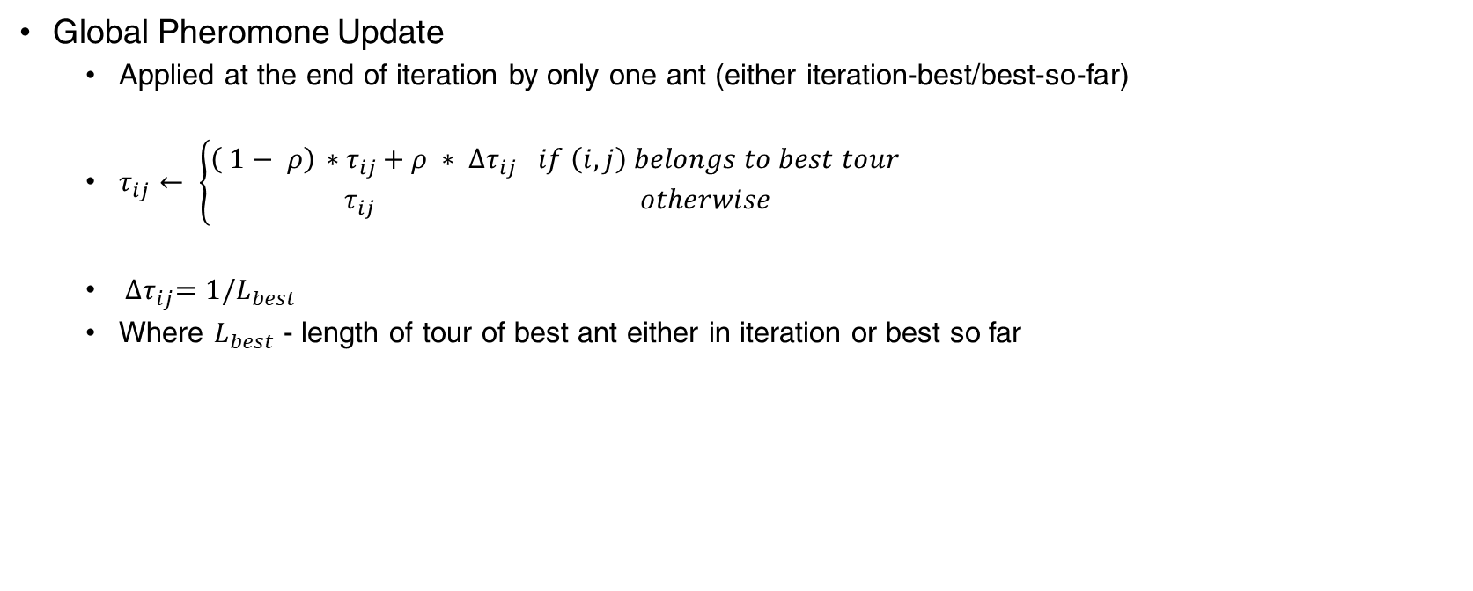
Ant Colony System: Global Update
Global Pheromone Update
Applied at the end of iteration by only one ant (either iteration-best/best-so-far)
$τ_{ij}← \left\{\begin{aligned}\left( 1− ρ\right){ ∗τ}_{ij}+{ρ ∗ ∆τ}_{ij} if \left(i,j\right) belongs to best tour \\ { τ}_{ij} otherwise\end{aligned}\right.$
${ ∆τ}_{ij}=1/L_{best}$
Where $L_{best}$ - length of tour of best ant either in iteration or best so far

Slide 49
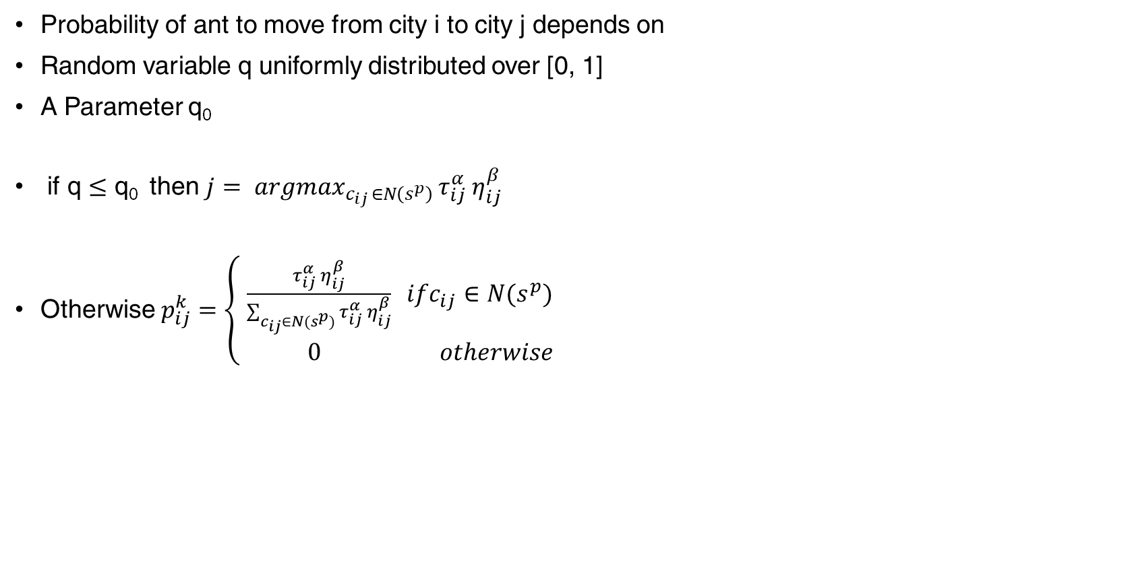
Ant Colony System: Transition
Probability of ant to move from city i to city j depends on
Random variable q uniformly distributed over [0, 1]
A Parameter q₀
if q $≤$ q₀ then $j= {argmax}_{c_{ij }∈N\left(s^{p}\right) }τ_{ij}^{α} η_{ij}^{β}$
Otherwise $p_{ij}^{k}=\left\{\begin{aligned}\frac{τ_{ij}^{α} η_{ij}^{β}}{\sum_{c_{ij}∈N(s^{p})}{τ_{ij}^{α} η_{ij}^{β}}} ifc_{ij}∈N(s^{p}) \\ 0 otherwise \end{aligned}\right.$

Slide 50
Basic Flow of ACO
Represent the solution space by a construction graph
Initialize ACO parameters
Generate random solutions from each ant’s random walk
Update pheromone information
Goto 3 and repeat until convergence or a stopping criteria is met

Slide 51
Applications of ACO
Traveling Salesman Problem – Finding the shortest route to cover all cities exactly once
Quadratic Assignment Problem – Assigning n facilities to n locations so that costs of assignment is minimized
Job-Shop Scheduling – Assigning jobs to machines in time intervals such that no two jobs are processed at the same time on same machine and operation time is minimized

Slide 52
Thank You!
In our next session:
AI & Gaming - Minimax

